Slide 1
Step Up Data with Shell Challenge Introduction

Slide 2
Welcome to the “Step Up” – Shell live online career challenge
What will you need?
A good wi-fi connection
A quiet environment where you will not be disturbed for 45 minutes!
What do we expect?
Respectful and appropriate behaviour throughout this 45-minute briefing session
A positive attitude and a willingness to learn
There will be a number of opportunities throughout today’s presentation to ask questions using the chat function.
How will you benefit from completing this challenge?
The opportunity to solve Shell’s business problem
To learn about how your current course can be applied to a career in data
Understand how valuable YOUR “Key skills” are when solving this problem and delivering the solution.
Gain a virtual work experience certificate
Any technical issues during this session – please email us on info@digdata.online

Slide 3
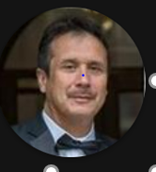



Meet the team
Moises Ensignia
CC Lead Sectors & decarb
Paul Spurgeon
DSML Competency Lead
Andy Smith
Data Scientist

Slide 4

About Shell
Shell is an international energy company with expertise in the exploration, production, refining and marketing of oil and natural gas, and the manufacturing and marketing of chemicals.
We use advanced technologies and take an innovative approach to help build a sustainable energy future. We also invest in power, including from low-carbon sources such as wind and solar; and new fuels for transport, such as advanced biofuel and hydrogen.
Notes:
Taken from ‘Who We Are’ section on www.shell.com

Slide 5






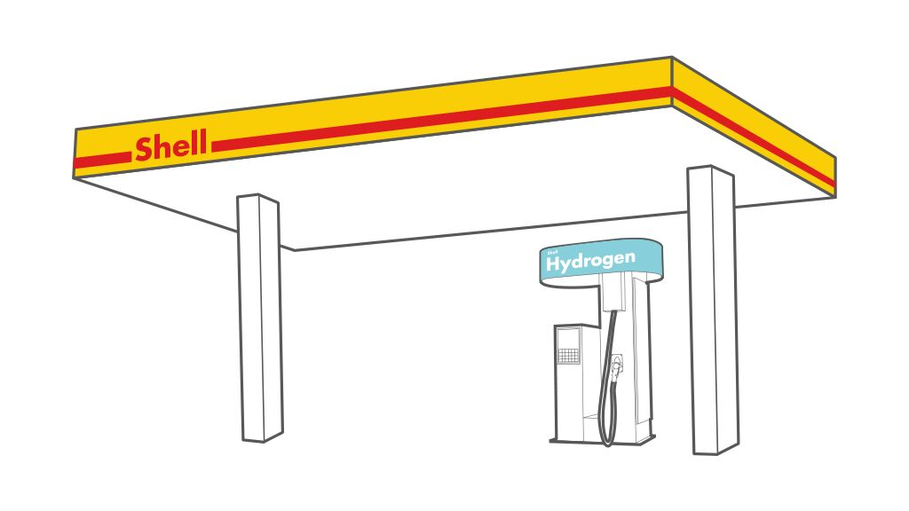

Shell – A sense of our scale
Customers
32 million
Emissions
18% reductions
In scope 1 & 2 emissions under our operational control
(compared with 2016 base year)
Cash flow
$45.1 billion
from operating activities
served every day through 46,000 Shell-branded retail stations
Lubricants
#1
supplier for 15 years, by market share
Sustainability reporting
25 years
achieved with our 2021 report
LNG
64 million
tonnes sold
R&D
$815 million
spent on Research and Development
LNG
Hydrogen
50
retail sites
Power
251
terawatt hours sold
STEM engagement
60,000
students engaged through NXplorers, our flagship STEM programme
EV charging points
90,000
All metrics accurate as of end 2021 with the exception of the Sustainability Reporting metric which is accurate as at the publish date of the 2021 Sustainability Report.
Notes:
Figures accurate as of per 2021 Annual Report How we create value - Shell Annual Report and Accounts 2021 or Shell Sustainability Report 2021 - Home

Slide 6
Shell’s Business Activities

Slide 7
Ice Breaker Slides
1. Who is Shell's CEO
a. Wael Sawan
b. Ben Van Beurden

Slide 8
Ice Breaker Slides
2. Where is Shell's headquarters
a. Netherlands
b. UK

Slide 9
Ice Breaker Slides
3. How many countries does Shell operate in
a. 30+
b. 70+

Slide 10
Ice Breaker Slides
4. How many employees work for Shell
a. 30,000 +
b. 80,000 +

Slide 11
Ice Breaker Slides
5. True or False - Shell is using AI to improve construction safety

Slide 12
Ice Breaker Slides
6. When was Shell formed
a. 1957
b. 1907

Slide 13
Ice Breaker Slides
7. Shell aims to reach it's net zero emissions by
a. 2060
b. 2050

Slide 14
Data Strategy Challenge Overview
Powering Progress is Shell’s strategy to accelerate the transition of our business to net-zero emissions. Designed to create value for our shareholders, customers and wider society, it has four main goals: achieving net-zero emissions, powering lives, respecting nature and generating shareholder value. See examples of our strategy in action below.
Producing and Selling Hydrogen is one of the many ways Shell is exploring to Achieve Net-Zero emissions. Net zero emissions include the
Shell's strategy to achieve net-zero emissions
Shell's target is to become a net-zero emissions energy business by 2050.
To help step up the pace of change, in October 2021, we set a target to reduce absolute emissions by 50% by 2030, compared to 2016 levels on a net basis. This covers all emissions in Scope 1, which come directly from our operations, and in Scope 2, from the energy we buy to run our operations, under our operational control.
This complements our targets to reduce the carbon intensity (Net Carbon Footprint) of the energy products we sell. This includes short-term targets of 3-4% by 2022, 6-8% by 2023 and 9-12% by 2024 (compared to 2016).
It also includes medium- and long-term targets of 20% by 2030, 45% by 2035, and 100% by 2050 (compared to 2016).
We believe that our total oil production peaked in 2019 and we expect our oil production to gradually decline by 1-2% a year until 2030.
We are investing around $1 billion every year in low-carbon energy such as charging for electric vehicles, hydrogen, biofuels and electricity generated by wind and solar power. We plan on increasing that to around $2 billion, provided that we can find the right commercial opportunities.
By 2025, we expect to have kept the methane emissions intensity of Shell-operated assets to below 0.2%.

Slide 15
Data Strategy Challenge Overview(contd..)
We seek to have access to an additional 25 million tonnes a year of carbon capture and storage (CCS) capacity by 2035 – equal to 25 CCS facilities the size of our Quest site in Canada.
By 2025, we aim to end routine flaring of gas, which generates emissions, from the Upstream assets we operate.
The Challenge:
At Shell we have set a target to become a net-zero emissions energy business by 2050, in step with society and our customers. This means reducing emissions from our operations, and from the fuels and other energy products we sell to our customers (including providing more low-carbon energy such as biofuels, hydrogen, charging for electric vehicles and electricity generated by solar and wind power), as well as capturing and storing any remaining emissions using technology or balancing them with offsets. How can data and analytics help us transform our business and find and develop new opportunities in one or all of these areas to help us achieve our target?
Links to help with case study:
Transforming low-carbon energy supply and demand across sectors | Shell Global
Powering Progress in action | Shell Global
Achieving net-zero emissions | Shell Global
Building new supply chains - Shell Energy Transition Progress Report 2021
How is Shell accelerating to net zero? – YouTube

Slide 16
Data Science Challenge Overview
What is the best operating strategy for the Rotterdam plant to balance the use of wind power to produce green hydrogen versus using it to generate electricity for the Grid, providing green energy to homes, electric vehicles and businesses. How should this operation be optimized to ensure the project is commercially successful? Optimization would reflect a whole range of factors, including deciding when operations should switch from one use of the electricity to the other.
The objective of this task is to create a model that tells us when to use the electrolyser to generate hydrogen and when to run it in reverse to generate electricity
The model should create a recommendation at the start of the day for each hour in the day
The recommendations should be based on the actual situation at the end of the day and our forecasts for the future
The model should aim to maximise the profit we make from selling excess electricity to the grid less the costs of buying additional electricity from the grid
The model should ensure that there is always enough hydrogen available to meet demand at the plant
We have provided you with one year’s data to “train” your model
We will provide an additional month of data in the same format to evaluate your model

Slide 17



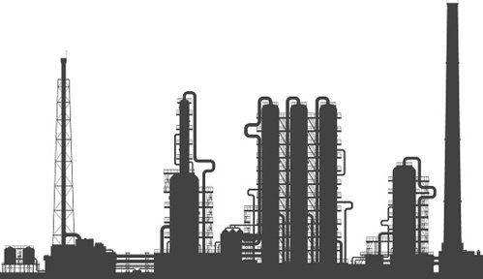

Operating Context
3
1
2
4
5
6
Our windfarm produces clean electricity when the wind blows
Electricity can be sold to the grid or used in our electrolyser
Electrolyser can also use electricity from the grid to produce hydrogen
Electrolyser can run in reverse to generate clean electricity to sell to the grid
Hydrogen is stored in tanks until it is used in our refinery or converted back to electricity
Our refinery requires a supply of green hydrogen

Slide 18
Operating Constraints
2
3
1
4
5
6
Windfarm output is variable depending an weather and operational factors, we can forecast output imperfectly
Electricity prices vary each hour according to market supply and demand, some but not all of the variability is predictable
Transaction costs mean we pay more to buy electricity than we receive when selling it
Some energy is lost in the process of converting electricity to hydrogen and back
Our storage tanks have a limited capacity
Our refinery requires hydrogen to operate, our planners can give us an indication of demand a month, a week and a day ahead, but we must never run out

Slide 19
What is your mission
To complete the task, we would like you to:
Analyse the data and build the model in whatever environment you feel comfortable (e.g. Python, Excel, R, etc)
Use whatever data science approaches you see appropriate
Present interesting insights from your exploratory analysis of the data
Tell us how you approached the task and developed your strategy
Describe your strategy in words that would give our business stakeholders confidence that it is sensible
Provide an estimate of how much profit your strategy would have generated if applied to the 12 months training data
Share your recommendation on how we should operate our electrolyser for each hour in the one-month evaluation period
Calculate the profit your strategy would generate when applied to the one-month evaluation period

Slide 20
Toolkit Introduction
We will provide you with:
Datasets that give you information
Windfarm Electricity Production (hourly) – Forecast and Actual
Market Electricity Prices (hourly) – Next Day and Spot
Factory Hydrogen Demand (daily) – Forecast and Actual
2. List of parameters with values
3. Data dictionary

Slide 21
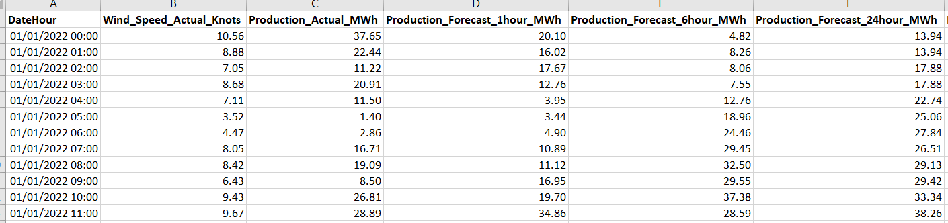
Understanding the data
You will be provided with the following hourly dataset:
Day and hour of year
Actual Wind Speed
Actual Power Output
Forecast Outputs for the wind at that time from the previous hour, 6 hours before and the day before
Windfarm Electricity Production (Actual and Forecasts)

Slide 22
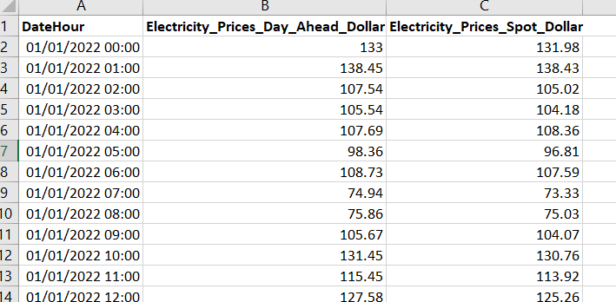
Understanding the data
You will be provided with the following hourly dataset:
Day and hour of year
Electricity Prices bought day ahead /KWh
Electricity Prices for on the day purchasing/KWh
Prices (Next Day and Spot)

Slide 23
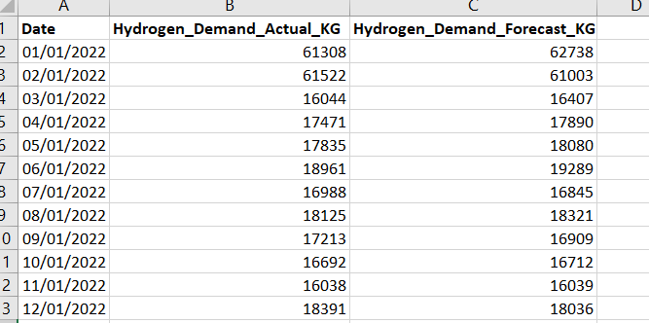
Understanding the data
Hydrogen demand in the factory is provided at daily level.
Day of year
Actual Demand in Kg
Forecast Demand in Kg
Factory Hydrogen Demand (Actual and Forecasts)*
Weekly and Monthly Forecasts will also be provided

Slide 24
Understanding the data
You will be provided additionally with parameters.
These can be used to create new fields in your working data set.
Parameter | Description | Value
Hydrogen Storage Capacity (Kg) | Maximum quantity of Hydrogen that can be stored | 86 Tonnes
Hydrogen Storage Level 1st Jan 2022 | Starting level of storage tank | 10 Tonnes
Conversion Efficiency (%) | Converting electricity to hydrogen or hydrogen to electricity results in a loss – 74% is retained | 74%
Conversion Rate (KWh/Kg) | The quantity of Hydrogen in Kg that can be produced with 1KWh | 40
Electrolyser Turnaround Time (Hour) | The time the electrolyser is out of use, so producing neither hydrogen nor electricity when direction changed from electricity -> hydrogen or hydrogen -> electricity | 0.5
Electricity Market Overhead Cost ($) | A 10% transaction cost to be added to the electricity market price when buying | 10%

Slide 25
Hints and Tips
Start with Exploratory Data Analysis (explore and visualise)
Check data quality
Pull top level insights from the data (Predicted vs Actuals, low wind days, any seasonality)
Frame the problem in terms of the data
Calculate new columns, for example, in an hour how much potential hydrogen could be generated (Kg) from the electricity (KWh), how much would it sell for on the market?
Consider ways to aggregate the hourly data to compare to the daily hydrogen demand (and how to do this in your chosen software)

Slide 26
Hints and Tips
Start simple, Consider a simple starting strategy. For example, “Every day I will start, hour by hour, by converting any wind power to green hydrogen. Once I hit the hour when the factory demand for the day is met, I will sell electricity for the remainder of the day”. How much profit does this generate?
Could the hourly wind power forecasts, hourly next day prices, hydrogen storage be used to develop a more profitable strategy? Create, test and compare.
Remember that actuals are not known the day before – use forecasts or next day prices
For the more adventurous, could a machine learning approach be used to predict the best strategy (out of different possible strategies) i.e. the most profitable for the following day based on the forecasts and predictions for that day?
Have fun!

Slide 27
What happens now?
Digdata will send you:
PowerPoint presentation
Data set (Excel worksheet)
How to Guide
Live session recording
What happens in 6 days?
Test data set emailed to all students
When is the Shell career challenge deadline?
Wednesday 15th March at 6pm
Send all of your work to info@digdata.online and you will receive your virtual work experience certificate within 14 days.

